Slide 1
Next-Gen Email Classifier Demo
By CtrlAltWin

Slide 2
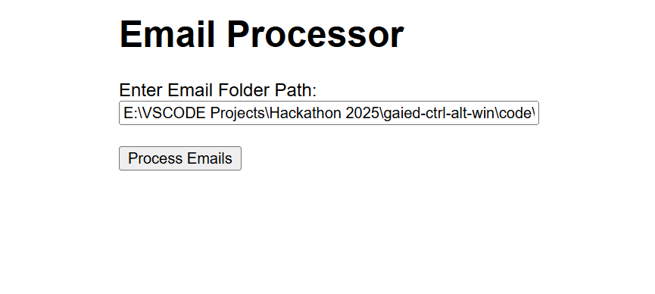
Upload the path, where emails to be processed are present

Slide 3
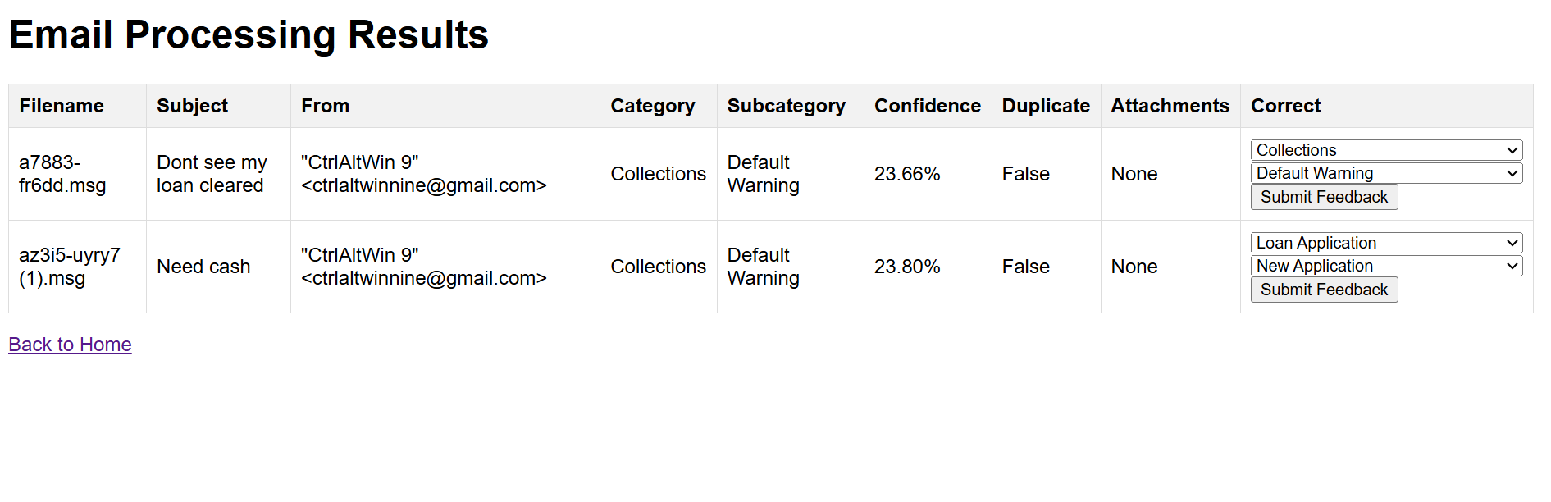
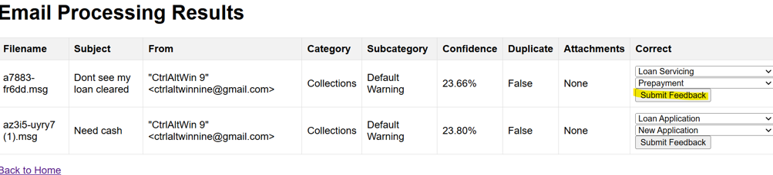
.msg files along with attachments can be processed and it provides its analysis as shown above.
The person who is working on the case can review it, modify the classification and send as a feedback.
Subsequent requests will be trained based on the previous inputs.

Slide 4
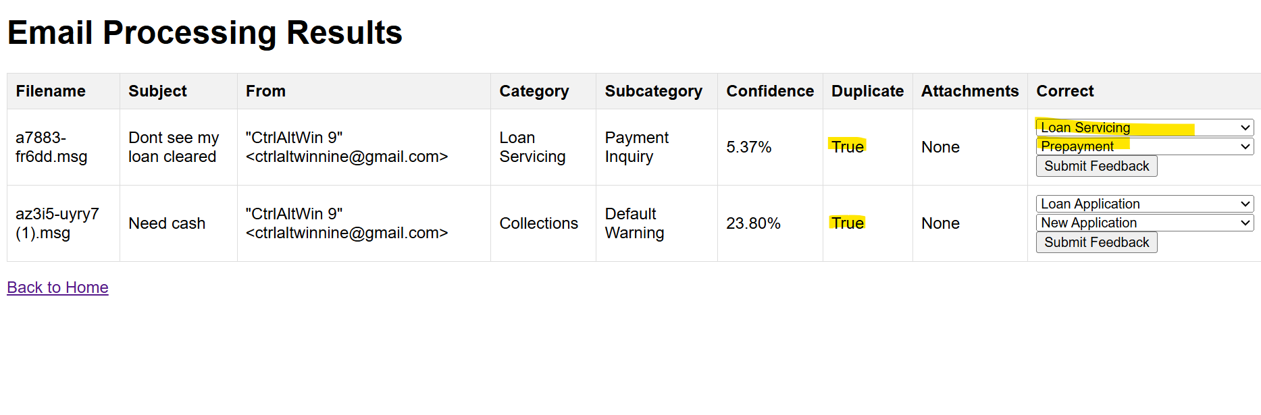
Duplicate emails, Confidence scores will be identified for each email request.

Slide 5
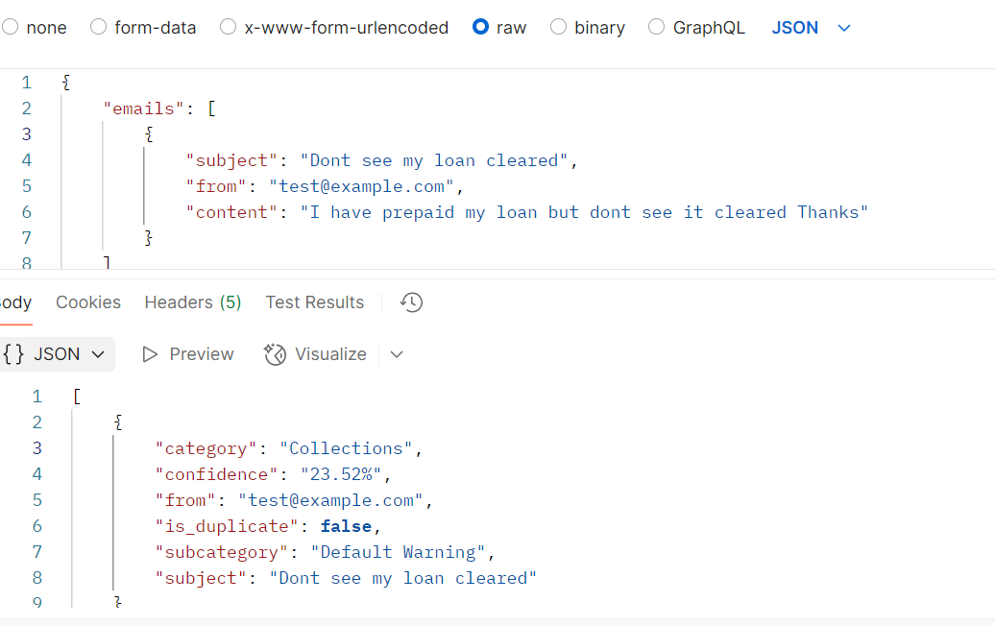
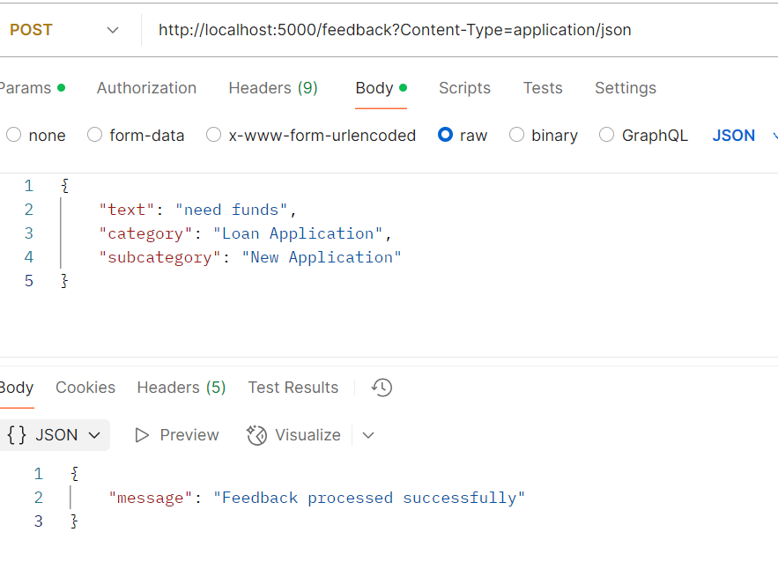
Api end points also created for processing email and posting feedback

